Slide 1
Speech Signal Analysis
Most slides come from http://www.inf.ed.ac.uk/teaching/courses/asr/2019-20/asr04-signal.pdf
Ying shen
School of software engineering
Tongji university

Slide 2
Speech signal analysis for ASR
Decoded Text
(Transcription)
Recorded Speech
Signal Analysis
Acoustic Model
Search Space
Language Model
Training Data

Slide 3
Content
Features for ASR
Spectral analysis
Cepstral analysis
Standard features for ASR: FBANK, MFCCs and PLP analysis
Dynamic features

Slide 4
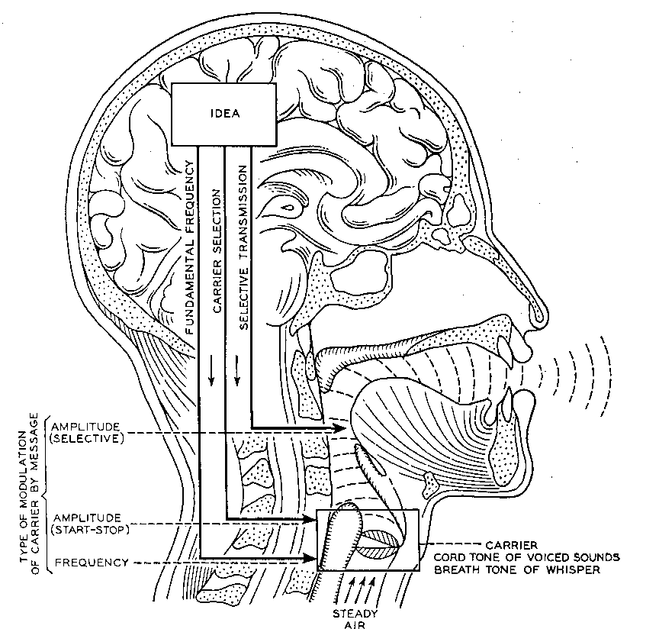
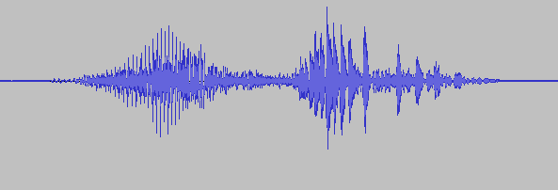

A/D conversion
Convert analogue signals in digital form
Sound pressure wave
“你好”

Slide 5
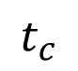
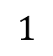

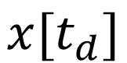
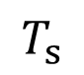
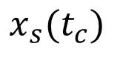
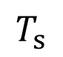
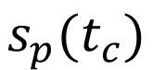
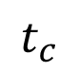
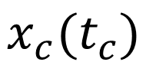
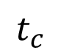
A/D conversion
Convert analogue signals in digital form
Microphone
$$s_{p}(t_{c})$$
$$1$$
Sound pressure wave
$$T_{s}$$
$$x_{c}(t_{c})$$
$$⊗$$
Conversion from impulse train to discrete−time sequence
$$x[t_{d}]$$
$$x_{s}(t_{c})$$
$$t_{c}$$
$$t_{c}$$
$$t_{c}$$
$$T_{s}$$

Slide 6
A/D conversion - Sampling
Convert analogue signals in digital form
Microphone
$$s_{p}(t_{c})$$
$$1$$
Sound pressure wave
$$T_{s}$$
$$x_{c}(t_{c})$$
$$⊗$$
Conversion from impulse train to discrete−time sequence
$$x[t_{d}]$$
$$x_{s}(t_{c})$$
$$t_{c}$$
$$t_{c}$$
$$t_{c}$$
$$T_{s}$$
Notes:
声压就是大气压受到声波扰动后产生的变化，即为大气压强的余压，它相当于在大气压强上的叠加一个声波扰动引起的压强变化
声音发出导致话筒内部线圈切割磁场产生电流，从而发电
声压的单位是帕斯卡（pa），其计算公式为：
声压（p）的平方=声强（I）×介质密度（ρ）×声速（C）
其中，声强单位是：W/m2 密度单位：kg/m3 声速：m/s

Slide 7
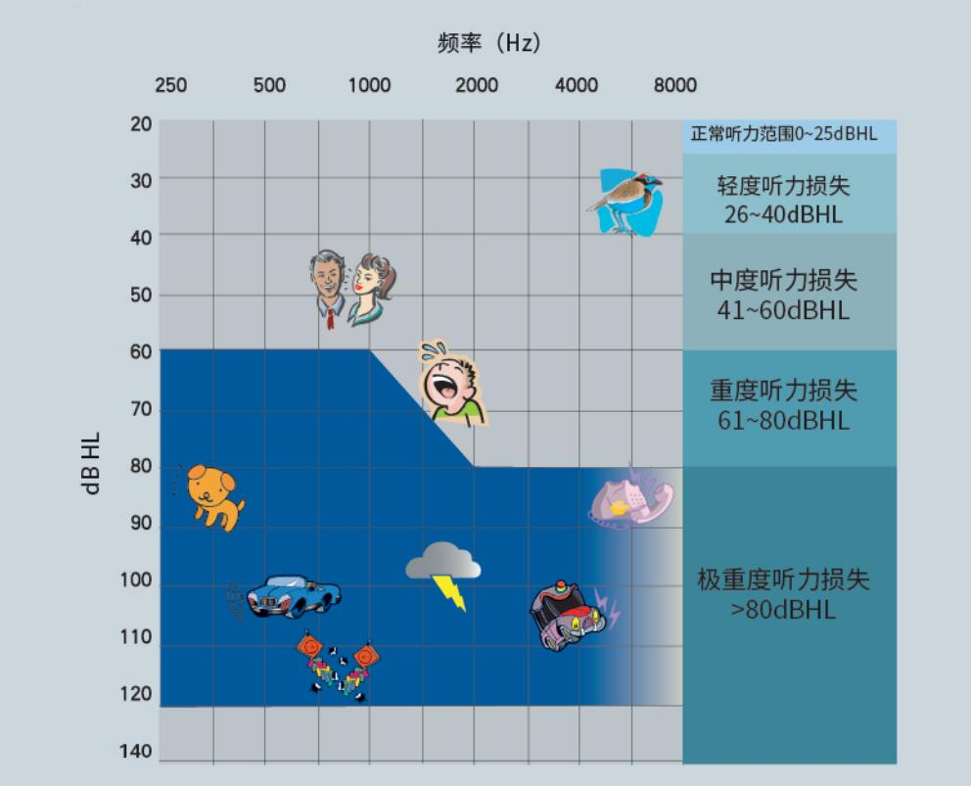
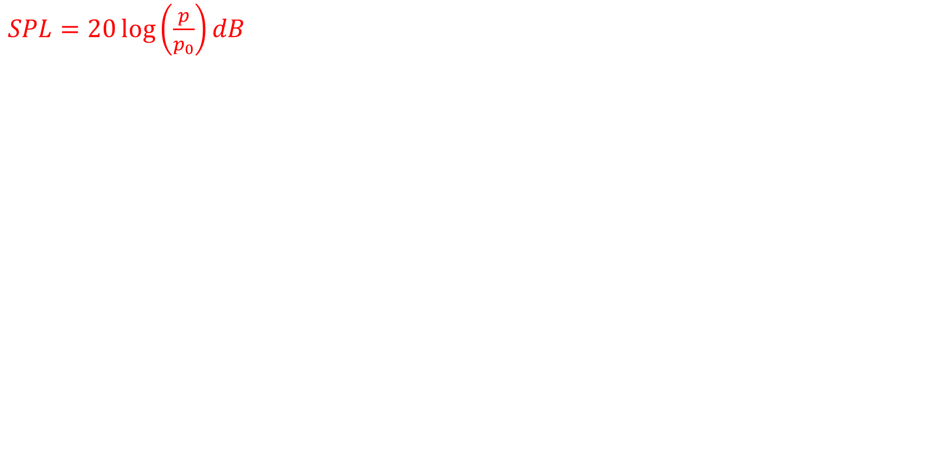
A/D conversion - Sampling
$SPL=20\log\left(\frac{p}{p_{0}}\right)dB$
Notes:
在空气中参考声压p(ref）一般取为2*10E-5帕，这个数值是正常人耳对1千赫声音刚刚能觉察其存在的声压值，也就是1千赫声音的可听阈声压。一般讲，低于这一声压值，人耳就再也不能觉察出这个声音的存在了。显然该可听阈声压的声压级即为零分贝。
1分贝是人类耳朵刚刚能听到的声音，20分贝以下的声音，一般来说，我们认为它是安静的，当然，一般来说15分贝以下的我们就可以认为它属于"死寂"的了。
20-40分贝大约是情侣耳边的喃喃细语。40-60分贝属于我们正常的交谈声音。60分贝以上就属于吵闹范围了，70分贝我们就可以认为它是很吵的，而且开始损害听力神经，90分贝以上就会使听力受损，而呆在100-120分贝的空间内，如无意外，一分钟人类就得暂时性失聪（致聋）。

Slide 8
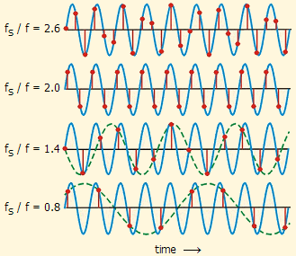
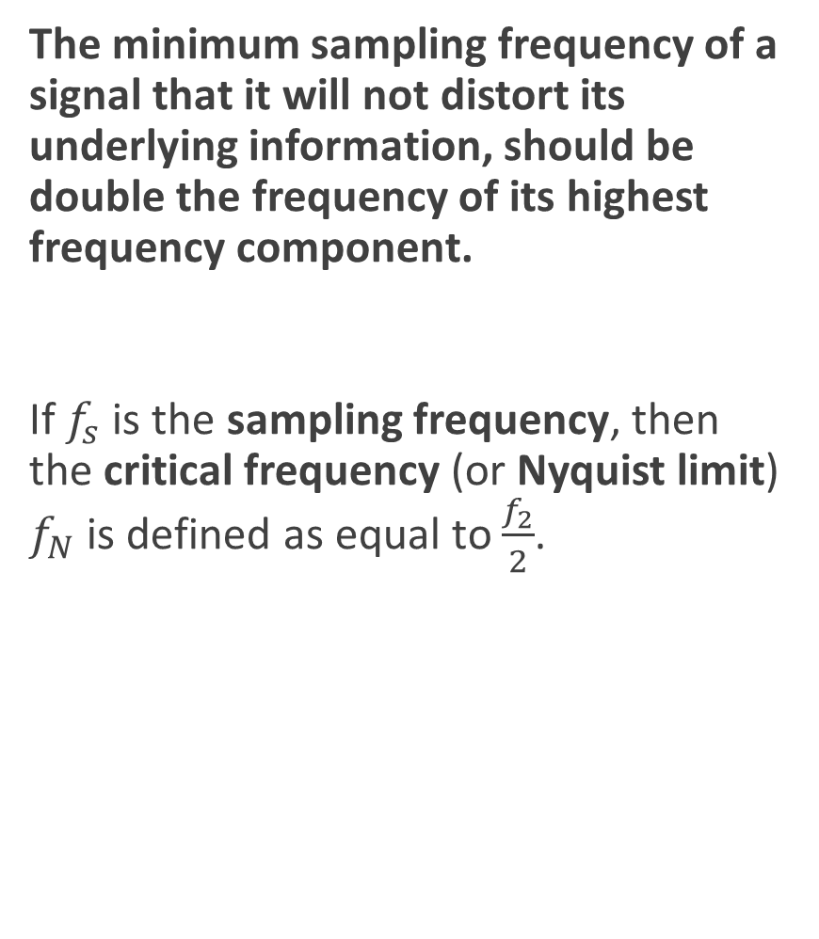
Nyquist-Shannon sampling theorem
The minimum sampling frequency of a signal that it will not distort its underlying information, should be double the frequency of its highest frequency component.
If $f_{s}$ is the sampling frequency, then the critical frequency (or Nyquist limit) $f_{N}$ is defined as equal to $\frac{f_{2}}{2}$.
Notes:
声音的采样需满足采样定理：当采样率大于信号最高频率的两倍时，采样数字信号能够完整保留原始信号中的信息
http://195.134.76.37/applets/AppletNyquist/Appl_Nyquist2.html

Slide 9
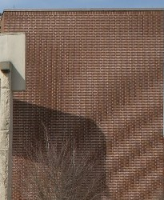
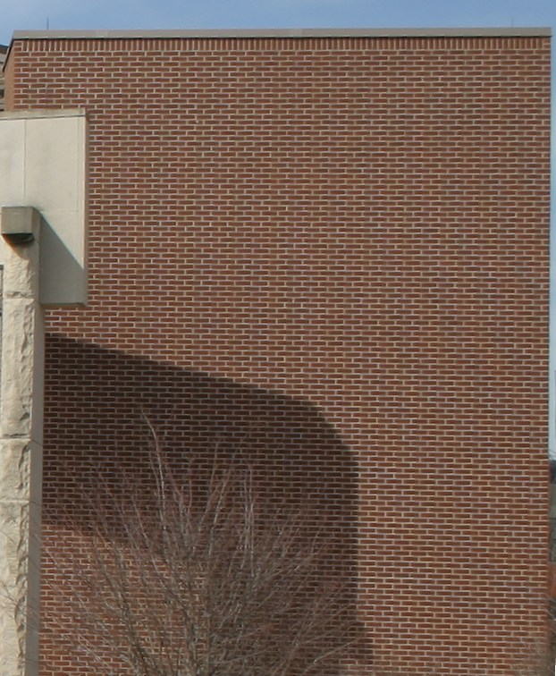
Nyquist-Shannon sampling theorem
The minimum sampling frequency of a signal that it will not distort its underlying information, should be double the frequency of its highest frequency component.
If $f_{s}$ is the sampling frequency, then the critical frequency (or Nyquist limit) $f_{N}$ is defined as equal to $\frac{f_{2}}{2}$.
Notes:
http://195.134.76.37/applets/AppletNyquist/Appl_Nyquist2.html

Slide 10
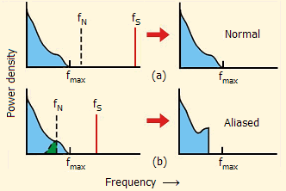
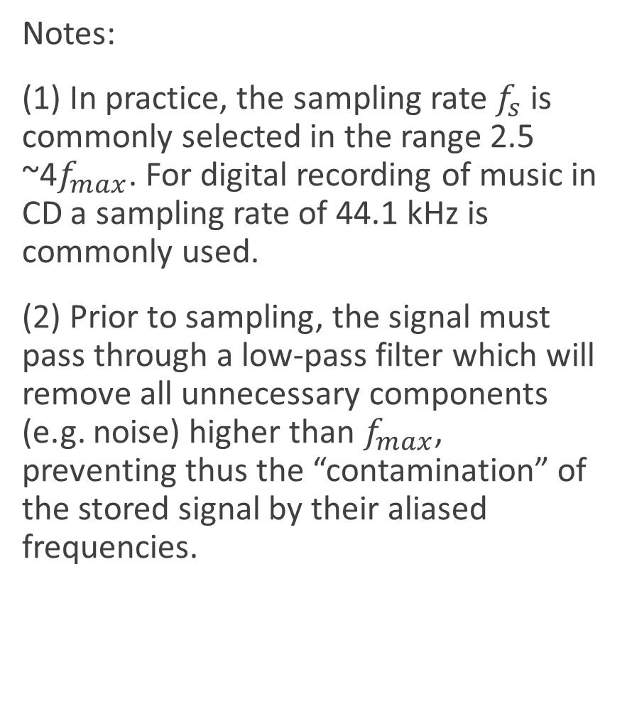
Nyquist-Shannon sampling theorem
Notes:
(1) In practice, the sampling rate $f_{s}$ is commonly selected in the range 2.5 ~4$f_{max}$. For digital recording of music in CD a sampling rate of 44.1 kHz is commonly used.
(2) Prior to sampling, the signal must pass through a low-pass filter which will remove all unnecessary components (e.g. noise) higher than $f_{max}$, preventing thus the “contamination” of the stored signal by their aliased frequencies.
Notes:
人耳听到的频率是20Hz-20kHz，发声的基音频率在70Hz-450Hz，经过口腔鼻腔产生的谐波（周期性信号）频率一般在4kHz内，但也有部分在4hHz-8kHz

Slide 11
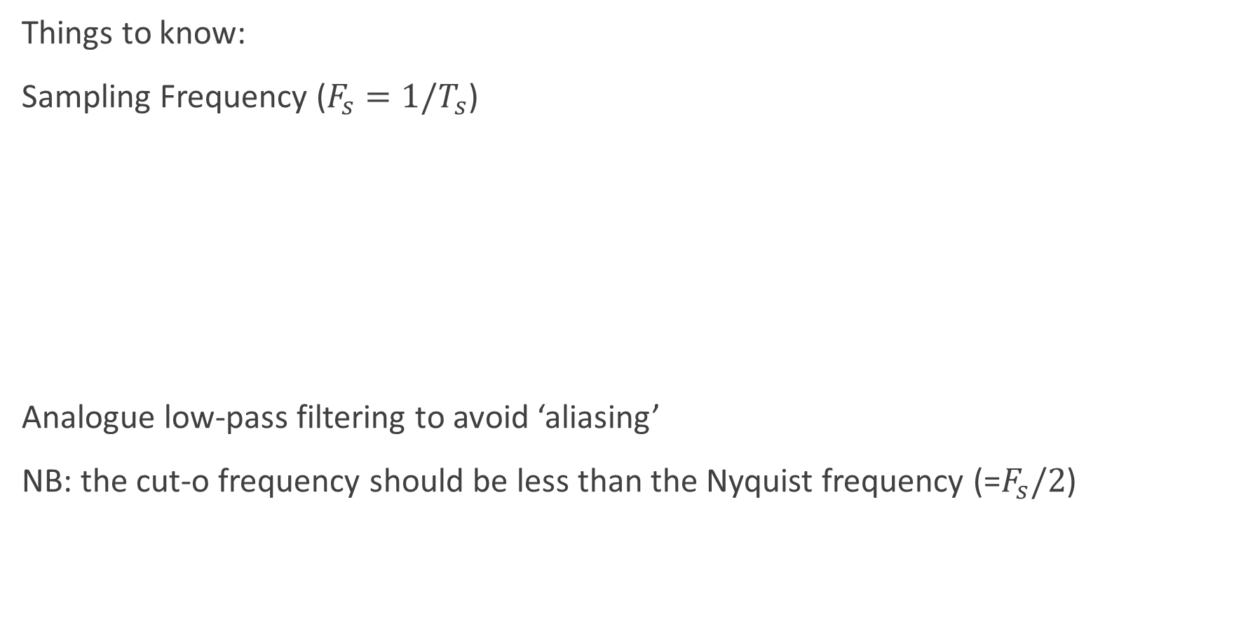
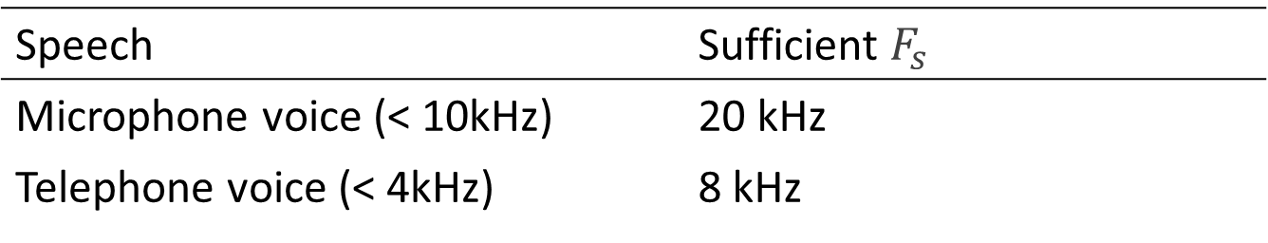
A/D conversion – Sampling
Things to know:
Sampling Frequency ($F_{s}=1/T_{s}$)
Analogue low-pass filtering to avoid ‘aliasing’
NB: the cut-o frequency should be less than the Nyquist frequency (=$F_{s}/2$)
Speech | Sufficient $F_{s}$
Microphone voice (< 10kHz) | 20 kHz
Telephone voice (< 4kHz) | 8 kHz
Notes:
人耳能听到的频率范围20Hz-20kHz，发音的基音频率在70Hz-450Hz，经过口腔鼻腔产生的谐波频率一般在4kHz内，也有部分在4kHz-8kHz

Slide 12
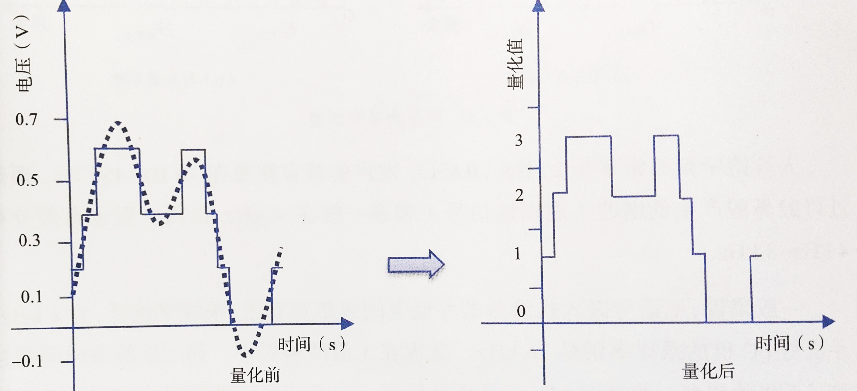
A/D conversion – Quantization

Slide 13
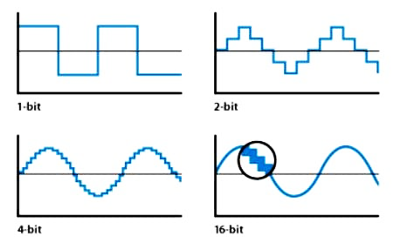
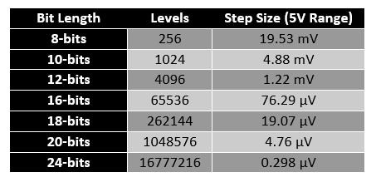
A/D conversion – Code scheme
The resolution of the ADC can be determined by its bit length
Notes:
The input samples are usually stored electronically in binary form within the ADC, so the resolution is usually expressed as the audio bit depth. In consequence, the number of discrete values available is usually a power of two. For example, an ADC with a resolution of 8 bits can encode an analog input to one in 256 different levels (2⁸ = 256). The values can represent the ranges from 0 to 255 (i.e. as unsigned integers) or from −128 to 127 (i.e. as signed integer), depending on the application.

Slide 14
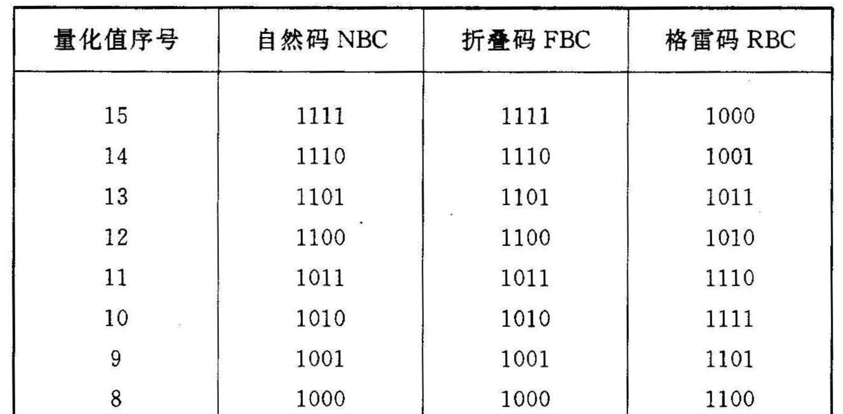
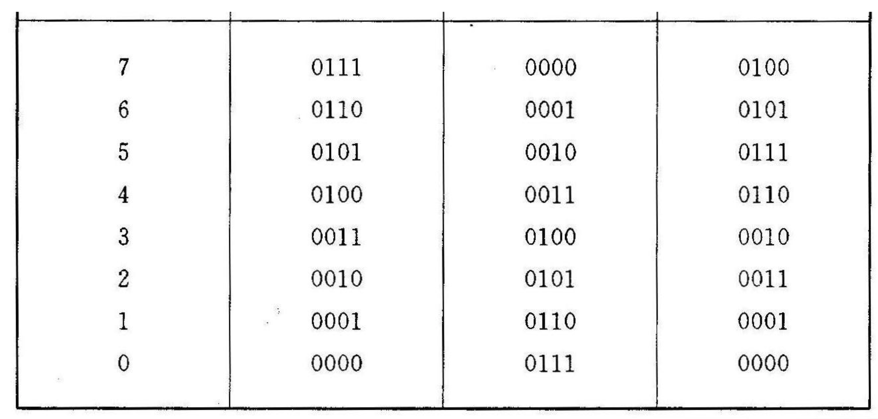
A/D conversion – Code scheme
NBC (Natural Binary Code), FBC (Folded Binary Code), RBC (Grayor Reflected Binary Code)

Slide 15
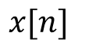
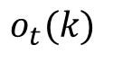
Acoustic Features for ASR
Speech signal analysis to produce a sequence of acoustic feature vectors
Sampled signal
ASR
Front End
Acoustic Feature Vectors
Acoustic Model
$$x[n]$$
$$o_{t}(k)$$

Slide 16
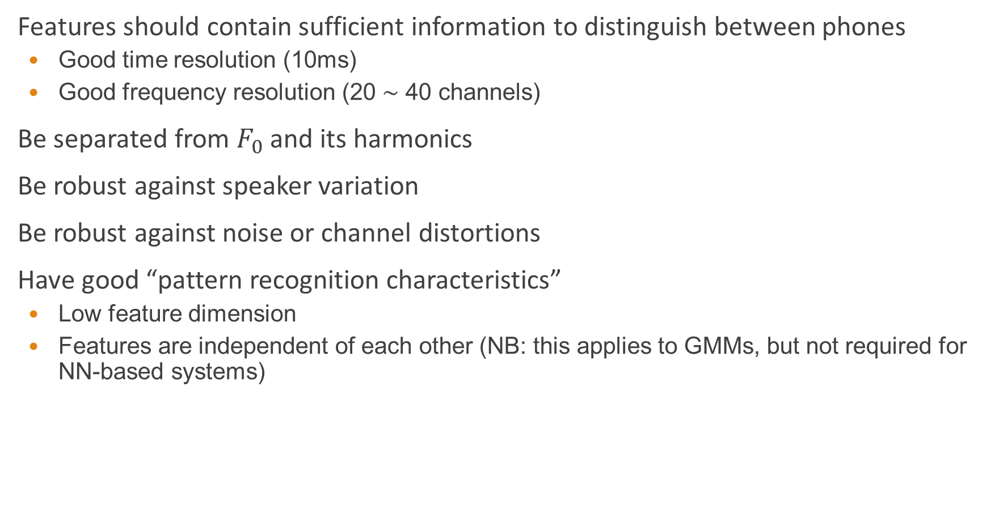
Acoustic Features for ASR
Features should contain sufficient information to distinguish between phones
Good time resolution (10ms)
Good frequency resolution (20 ∼ 40 channels)
Be separated from $F_{0}$ and its harmonics
Be robust against speaker variation
Be robust against noise or channel distortions
Have good “pattern recognition characteristics”
Low feature dimension
Features are independent of each other (NB: this applies to GMMs, but not required for NN-based systems)
Notes:
f0 – Also known as the fundamental frequency, f0 is a property of the source and is perceived by the ear as pitch. The f0 of the adult human voice ranges from 100-300 Hz.
The fundamental frequency or F0 is the frequency at which vocal chords vibrate in voiced sounds. This frequency can be identified in the sound produced, which presents quasi-periodicity, the pitch period being the fundamental period of the signal (the inverse of the fundamental frequency). Pitch is more often used to refer to how the fundamental frequency is perceived.

Slide 17
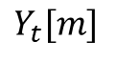
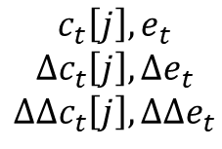
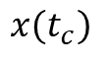
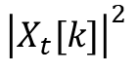
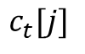
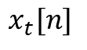
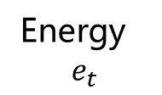
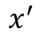
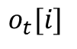
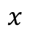
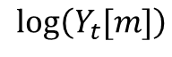
MFCC-based front end for ASR
$$x(t_{c})$$
A/D Conversion
Preempahsis
Windowing
$$x$$
$$x^{′}$$
$$x_{t}[n]$$
DFT
Energy
$$e_{t}$$
$${\left|X_{t}[k]\right|}^{2}$$
Mel filterbank
$$Y_{t}[m]$$
log()
$$\log\left(Y_{t}[m]\right)$$
Acoustic Model
Feature Transform
Dynamic
features
DCT
$$o_{t}[i]$$
$$c_{t}\left[j\right],e_{t}$$
$$∆c_{t}\left[j\right],∆e_{t}$$
$$∆∆c_{t}\left[j\right],∆∆e_{t}$$
$$c_{t}[j]$$
Notes:
https://haythamfayek.com/2016/04/21/speech-processing-for-machine-learning.html
https://wiki.aalto.fi/display/ITSP/Cepstrum+and+MFCC

Slide 18
Pre-emphasis and spectral tilt
Pre-emphasis increases the magnitude of higher frequencies in the speech signal compared with lower frequencies
Spectral Tilt
The speech signal has more energy at low frequencies (for voiced speech)
This is due to the glottal source (see the figure)
Pre-emphasis (first-order) filter boosts higher frequencies:
$$x^{′}\left[n\right]=x\left[n\right]−αx\left[n−1\right], 0.95<α<0.99, 1≤n≤\# of samples$$
Notes:
语音信号的预加重，目的是为了对语音的高频部分进行加重，去除口唇辐射的影响，增加语音的高频分辨率。对于语音信号，我们需要进行这步是因为高频信号的信息量更大。一般来说元音的频率更低，辅音的频率更高。假如给你一个单词 Microsoft，如果只保留辅音部分 Mcsft，还是可以明白它表达了什么，这就是为什么说辅音的信息量更大。

Slide 19
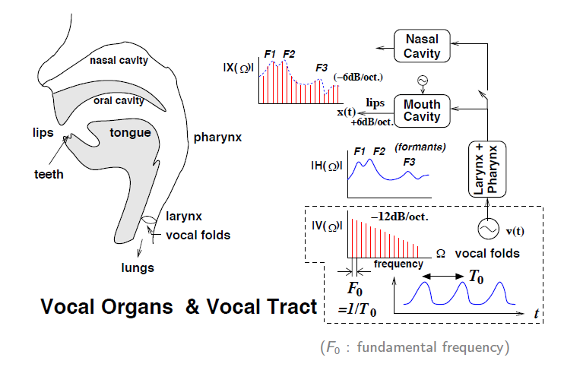
Speech production model
Notes:
语言发音模型的理论基础是言语产生的声学理论。根据 Stevens 的观点，声门把气流通道分成了上下两部分，对于大多数语音的产生过程而言，声门以下的系统提供了气流能量，喉部和声门以上的结构对气流进行调制，产生可以听到的声音。经过对语音进行深入研究，学者们普遍认为：（1）由声带震动产生周期信号，通过声道共鸣，形成浊音；（2）由气流爆破或者摩擦产生非周期噪声，形成清音；（3）清音和浊音经过唇、鼻辐射，在空间进行传播，形成语音。根据这种理论，只要掌握了声源、共鸣、辐射的声学规律，就可以模拟语音的产生过程。

Slide 20
Pre-emphasis and spectral tilt
Notes:
你好.wav

Slide 21
Windowing
The speech signal is constantly changing (non-stationary)
Signal processing algorithms usually assume that the signal is stationary
Piecewise stationarity: model speech signal as a sequence of frames (each assumed to be stationary)

Slide 22
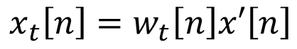
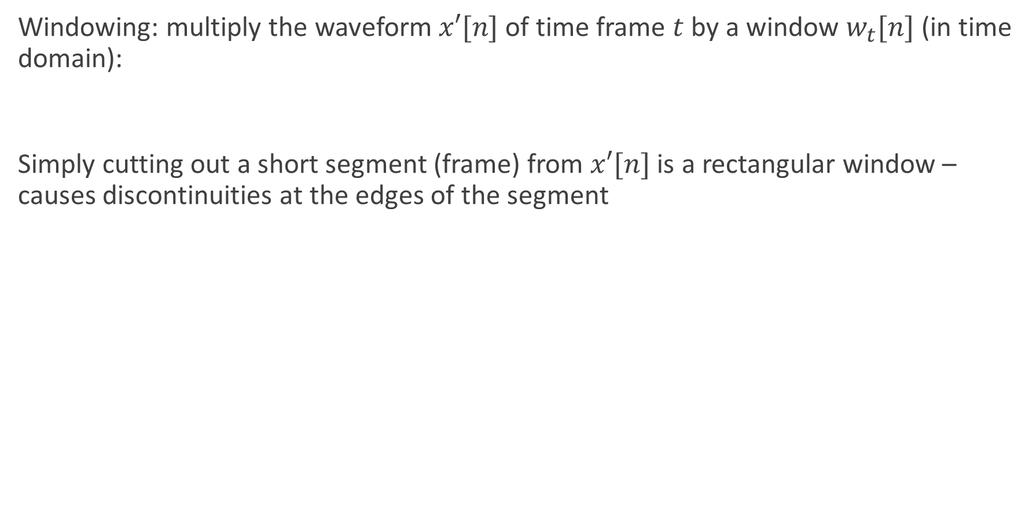
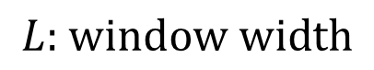
Windowing
Windowing: multiply the waveform $x′[n]$ of time frame $t$ by a window $w_{t}[n]$ (in time domain):
Simply cutting out a short segment (frame) from $x′[n]$ is a rectangular window – causes discontinuities at the edges of the segment
$$x_{t}\left[n\right]=w_{t}\left[n\right]x′\left[n\right]$$
$$w_{t}\left[n\right]=\left\{\begin{aligned}1, \\ 0,\end{aligned}\right. \begin{matrix}\left(t−1\right)∗L≤n≤t∗L−1 \\ n≤\left(t−1\right)∗L,n≥t∗L−1\end{matrix}, 1≤t≤\# of frames$$
$$L\text{: }\text{window} \text{width}$$

Slide 23
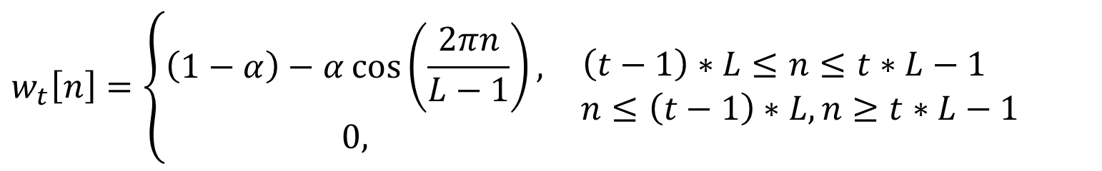
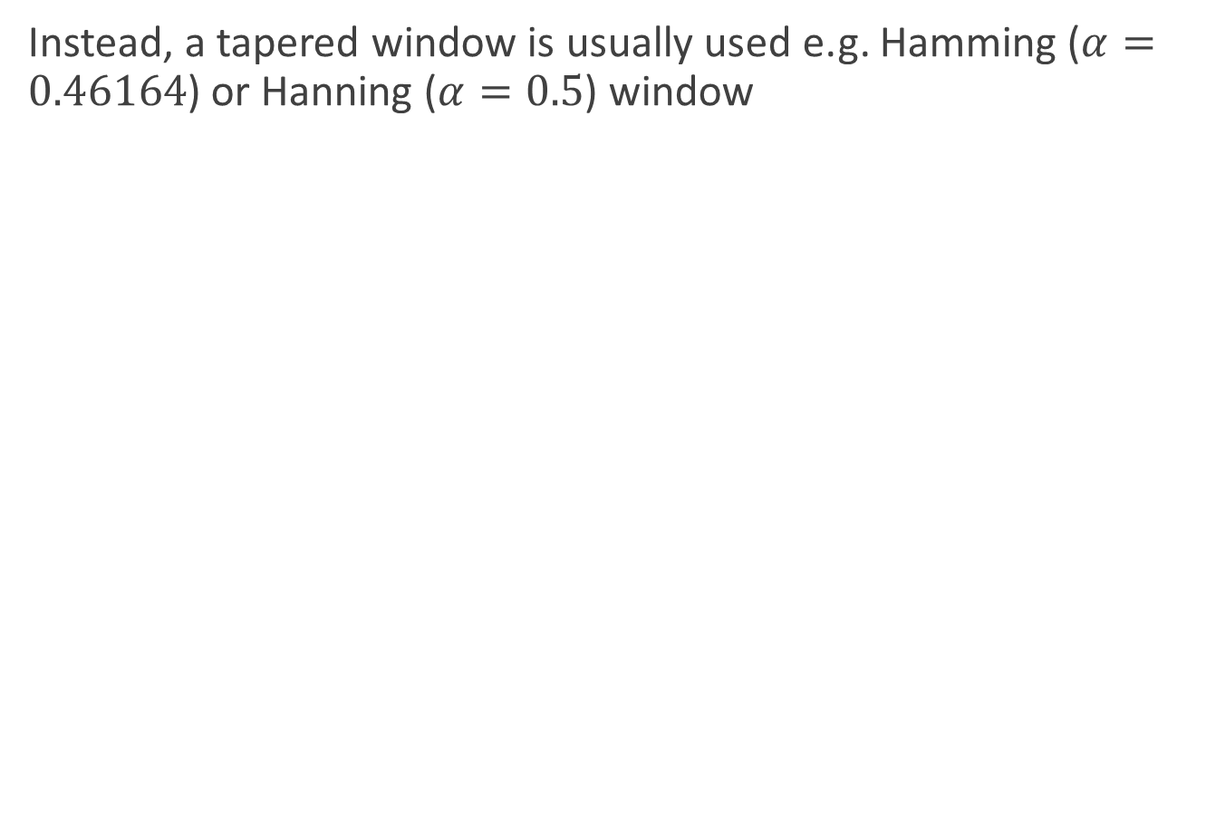
Windowing
Instead, a tapered window is usually used e.g. Hamming ($α=0.46164$) or Hanning ($α=0.5$) window
$$w_{t}\left[n\right]=\left\{\begin{aligned}\left(1−α\right)−α\cos\left(\frac{2πn}{L−1}\right), \\ 0,\end{aligned}\right. \begin{matrix}\left(t−1\right)∗L≤n≤t∗L−1 \\ n≤\left(t−1\right)∗L,n≥t∗L−1\end{matrix}$$

Slide 24
Windowing

Slide 25
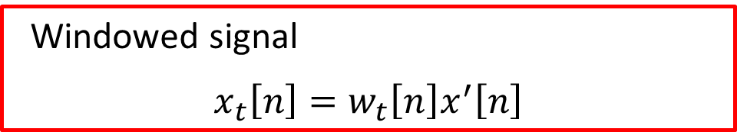
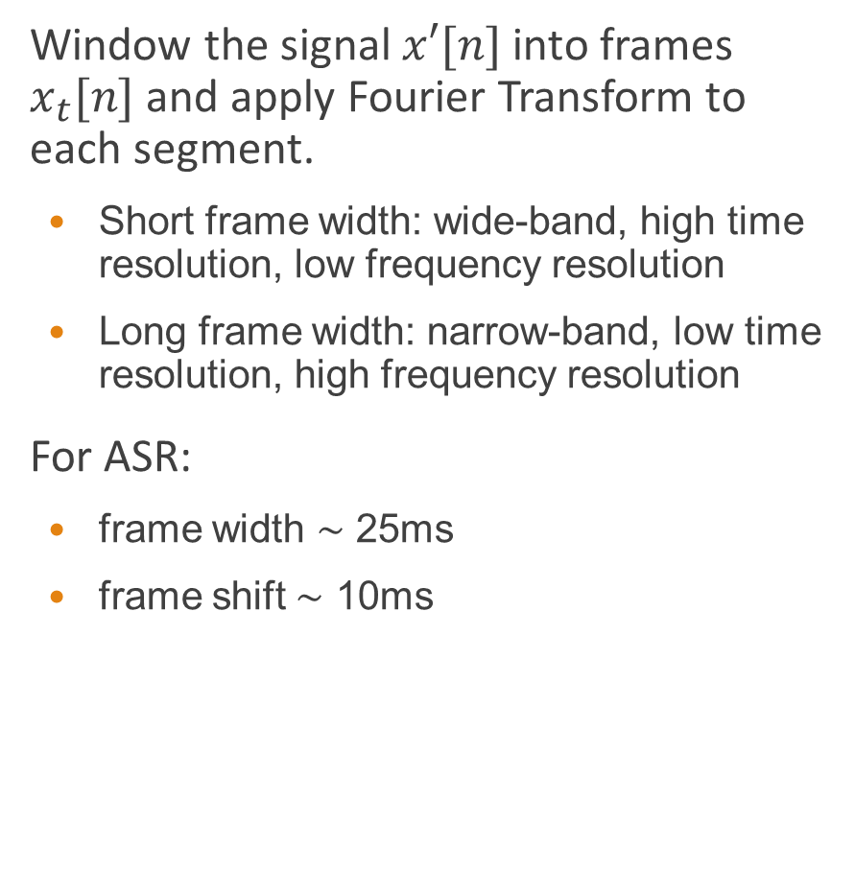
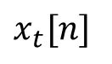

Windowing
Window the signal $x′[n]$ into frames $x_{t}[n]$ and apply Fourier Transform to each segment.
Short frame width: wide-band, high time resolution, low frequency resolution
Long frame width: narrow-band, low time resolution, high frequency resolution
For ASR:
frame width ∼ 25ms
frame shift ∼ 10ms
windowing
$x′[n]$
t-th frame
$x_{t}[n]$
0
L-1
Windowed signal
$$x_{t}\left[n\right]=w_{t}\left[n\right]x^{′}\left[n\right]$$
Notes:
宽带spectrogram: 以3ms(或300Hz左右的带宽)左右进行分帧之后制成的spectrogram
窄带spectrogram: 以20ms(或45Hz左右的带宽)左右进行分帧之后制成的spectrogram
对于τ=3 ms , 对应带宽为293Hz,
对于τ=20 ms ，对应带宽为44Hz.

Slide 26


Windowing
Window the signal $x′[n]$ into frames $x_{t}[n]$ and apply Fourier Transform to each segment.
Short frame width: wide-band, high time resolution, low frequency resolution
Long frame width: narrow-band, low time resolution, high frequency resolution
For ASR:
frame width ∼ 25ms
frame shift ∼ 10ms
windowing
shift
$x′[n]$
t+1-th frame
$x_{t+1}[n]$
0
L-1
Windowed signal
$$x_{t}\left[n\right]=w_{t}\left[n\right]x^{′}\left[n\right]$$

Slide 27



Discrete Fourier Transform (DFT)
Purpose: extracts spectral information from a windowed signal (i.e. how much energy at each frequency band)
Input: windowed signal $x[0], . . . , x[L−1]$(time domain, window size $L$)
Output: a complex number $X[k]$ for each of $N$ frequency bands representing magnitude and phase for the k-th frequency component (frequency domain)
Discrete Fourier Transform (DFT):
Fast Fourier Transform (FFT) — efficient algorithm for computing DFT when $N$ is a power of 2, and $N ≥ L$.
Spectrogram: ${\left|X\left[k\right]\right|}^{2}$, i.e., $abs\left(X\left[k\right]\right)$
$$X\left[k\right]=\sum_{n=0}^{N−1}{x\left[n\right]e^{−j\frac{2π}{N}kn}}$$
$$e^{jθ}=\cos\left(θ\right)+j\sin{(θ)}$$

Slide 28
DFT Spectrum
25ms Hamming window of “你好” speech (sample rate = 44100HZ) and its spectrum computed by DFT
Notes:
Window size = 1102 fft length=16384
“你好”5000-6102采样点

Slide 29

Windowing and spectral analysis
Window the signal $x′[n]$ into frames $x_{t}[n]$ and apply Fourier Transform to each segment.
Short frame width: wide-band, high time resolution, low frequency resolution
Long frame width: narrow-band, low time resolution, high frequency resolution
For ASR:
frame width ∼ 25ms
frame shift ∼ 10ms
windowing
$x′[n]$
t-th frame
$x_{t}[n]$
0
L-1
FFT
Magnitude
Frequency
Short−time power spectrum ${\left|X_{t}\left[k\right]\right|}^{2}$

Slide 30

Windowing and spectral analysis
Window the signal $x′[n]$ into frames $x_{t}[n]$ and apply Fourier Transform to each segment.
Short frame width: wide-band, high time resolution, low frequency resolution
Long frame width: narrow-band, low time resolution, high frequency resolution
For ASR:
frame width ∼ 25ms
frame shift ∼ 10ms
windowing
shift
$x′[n]$
t+1-th frame
$x_{t+1}[n]$
0
L-1
FFT
Magnitude
Frequency
Short−time power spectrum ${\left|X_{t+1}\left[k\right]\right|}^{2}$

Slide 31
Wide-band and narrow-band spectrograms
Wide band spectrogram
Window width = 2ms
Narrow band spectrogram
Window width = 20ms
Notes:
1. Sample points=132; noverlap=66,nfft=256
2. Sample points=882; noverlap=441,nfft=1024

Slide 32











MFCC-based front end for ASR
$$x(t_{c})$$
A/D Conversion
Preempahsis
Windowing
$$x[t_{d}]$$
$$x′[t_{d}]$$
$$x_{t}[n]$$
DFT
Energy
$$e_{t}$$
$${\left|X_{t}[k]\right|}^{2}$$
Mel filterbank
$$Y_{t}[m]$$
log()
$$\log\left(Y_{t}[m]\right)$$
Acoustic Model
Feature Transform
Dynamic
features
DCT
$$o_{t}[i]$$
$$c_{t}\left[j\right],e_{t}$$
$$∆c_{t}\left[j\right],∆e_{t}$$
$$∆∆c_{t}\left[j\right],∆∆e_{t}$$
$$c_{t}[j]$$

Slide 33
Human hearing
Technical terms
equal-loudness contours
Masking
auditory filters (critical-band filters)
critical bandwidth
Physical quality | Perceptual quality
Intensity | Loudness
Fundamental frequency | Pitch
Spectral shape | Timbre
Onset/offset time | Timing
Phase difference in binaural hearing | Location

Slide 34

Equal loudness contour

Slide 35


Nonlinear frequency scaling
Human hearing is less sensitive to higher frequencies -- thus human perception of frequency is nonlinear
Mel scale
Bark scale
$$f_{mel}\left(f\right)=1127\ln\left(1+\frac{f}{700}\right)$$
$$f_{bark}\left(f\right)=13\arctan\left(0.00076f\right)+3.5\arctan\left({\left(\frac{f}{7500}\right)}^{2}\right)$$
Notes:
The mel scale, named by Stevens, Volkmann, and Newman in 1937,^{[1]} is a perceptual scale of pitches judged by listeners to be equal in distance from one another. The reference point between this scale and normal frequency measurement is defined by assigning a perceptual pitch of 1000 mels to a 1000 Hz tone, 40 dB above the listener's threshold. Above about 500 Hz, increasingly large intervals are judged by listeners to produce equal pitch increments. As a result, four octaves on the hertz scale above 500 Hz are judged to comprise about two octaves on the mel scale. The name mel comes from the word melody to indicate that the scale is based on pitch comparisons.

Slide 36


Mel-Filter Bank
Each filter in the filter bank is triangular having a response of 1 at the center frequency and decrease linearly towards 0 till it reaches the center frequencies of the two adjacent filters where the response is 0
$$H_{m}\left[k\right]=\left\{\begin{aligned} 0, k<f\left(m−1\right) \\ \frac{k−f\left(m−1\right)}{f\left(m\right)−f(m−1)}, f\left(m−1\right)<k<f(m) \\ 1, k=f\left(m\right) \\ \frac{f\left(m+1\right)−k}{f\left(m+1\right)−f(m)}, f\left(m\right)<k<f(m+1) \\ 0, k>f\left(m+1\right) \end{aligned}\right.$$
Notes:
This is a set of 20-40 (26 is standard) triangular filters that we apply to the periodogram power spectral estimate from step 2
M是滤波器个数；K_bm是滤波器的临界频率；K是DFT变换的点数
http://practicalcryptography.com/miscellaneous/machine-learning/guide-mel-frequency-cepstral-coefficients-mfccs/

Slide 37


Mel-Filter Bank
Apply a mel-scale filter bank to DFT power spectrum to obtain mel-scale power spectrum
Each filter collects energy from a number of frequency bands in the DFT
Linearly spaced < 1000 Hz, logarithmically spaced > 1000 Hz
DFT(STFT) power spectrum ${\left|X[k]\right|}^{2}$
1
2
N
Frequency bins
Triangular band−pass filters
 |  | … |  | …
Mel-scale power spectrum $Y[m]$
1
2
M

Slide 38
Mel-Filter Bank
Apply a mel-scale filter bank to DFT power spectrum to obtain mel-scale power spectrum
Each filter collects energy from a number of frequency bands in the DFT
Linearly spaced < 1000 Hz, logarithmically spaced > 1000 Hz
DFT(STFT) power spectrum ${\left|X[k]\right|}^{2}$
1
2
N
Frequency bins
Triangular band−pass filters
 |  | … |  | …
Mel-scale power spectrum $Y[m]$
1
2
M

Slide 39
Mel-Filter Bank
Apply a mel-scale filter bank to DFT power spectrum to obtain mel-scale power spectrum
Each filter collects energy from a number of frequency bands in the DFT
Linearly spaced < 1000 Hz, logarithmically spaced > 1000 Hz
DFT(STFT) power spectrum ${\left|X[k]\right|}^{2}$
1
2
N
Frequency bins
Triangular band−pass filters
 |  | … |  | …
Mel-scale power spectrum $Y[m]$
1
2
M

Slide 40
Mel-Filter Bank
Apply a mel-scale filter bank to DFT power spectrum to obtain mel-scale power spectrum
Each filter collects energy from a number of frequency bands in the DFT
Linearly spaced < 1000 Hz, logarithmically spaced > 1000 Hz
DFT(STFT) power spectrum ${\left|X[k]\right|}^{2}$
1
2
N
Frequency bins
Triangular band−pass filters
 |  | … |  | …
Mel-scale power spectrum $Y[m]$
1
2
M

Slide 41
Mel-Filter Bank
Apply a mel-scale filter bank to DFT power spectrum to obtain mel-scale power spectrum
Each filter collects energy from a number of frequency bands in the DFT
Linearly spaced < 1000 Hz, logarithmically spaced > 1000 Hz
DFT(STFT) power spectrum ${\left|X[k]\right|}^{2}$
1
2
N
Frequency bins
Triangular band−pass filters
 |  | … |  | …
Mel-scale power spectrum $Y[m]$
1
2
M

Slide 42


An example of Mel-Filter Bank computation
The example will use 10 filterbanks because it is easier to display, in reality you would use 26-40 filterbanks.
Choose a lower and upper frequency: 300Hz~8000Hz (Suppose sample rate is 16KHz)
Using Eq. 1, convert the upper and lower frequencies to Mels. In our case 300Hz is 401.25 Mels and 8000Hz is 2834.99 Mels.
Because we will do 10 filterbanks, for which we need 12 points. This means we need 10 additional points spaced linearly between 401.25 and 2834.99. This comes out to:
Now use Eq. 2 to convert these back to Hertz:
$$m=f_{mel}\left(f\right)=1127\ln\left(1+\frac{f}{700}\right)$$
(1)
$m(i)$ = 401.25, 622.50, 843.75, 1065.00, 1286.25, 1507.50, 1728.74, 1949.99, 2171.24, 2392.49, 2613.74, 2834.99
$${f=f}_{mel}^{−1}\left(m\right)=700(e^{\frac{m}{1127}}−1)$$
(2)
$h(i)$= 300, 517.33, 781.90, 1103.97, 1496.04, 1973.32, 2554.33,3261.62, 4122.63, 5170.76, 6446.70, 8000

Slide 43


An example of Mel-Filter Bank computation
The example will use 10 filterbanks because it is easier to display, in reality you would use 26-40 filterbanks.
Suppose DFT has 512 bins. Round those frequencies to the nearest FFT bin.
Now we create our filterbanks.
$$f(i) = floor(\left(nfft+1\right)\frac{h\left(i\right)}{F_{s}})$$
(3)
$f(i)$= 9, 16, 25, 35, 47, 63, 81, 104, 132, 165, 206, 256
$$H_{m}\left[k\right]=\left\{\begin{aligned} 0, k<f\left(m−1\right) \\ \frac{k−f\left(m−1\right)}{f\left(m\right)−f\left(m−1\right)}, f\left(m−1\right)≤k<f(m) \\ 1, k=f\left(m\right) \\ \frac{f\left(m+1\right)−k}{f\left(m+1\right)−f(m)}, f\left(m\right)<k≤f(m+1) \\ 0, k>f\left(m+1\right) \end{aligned}\right.$$

Slide 44

An example of Mel-Filter Bank computation
A Mel-filterbank containing 10 filters. This filterbank starts at 0Hz and ends at 8000Hz. This is a guide only, the worked example above starts at 300Hz.

Slide 45


Mel-Filter Bank (Cont.)
How many number of mel-filter channels?
$≈20$ for GMM-HMM based ASR
$20\sim 40$ for DNN-HMM based ASR
$$Y_{t}[m]=\sum_{k=1}^{N}{H_{m}\left[k\right]{\left|X_{t}\left[k\right]\right|}^{2}}$$
where k: DFT bin number (1,…,N)
m: mel-filter bank number (1,…,M)

Slide 46
MFCC-based front end for ASR
$$x(t_{c})$$
A/D Conversion
Preempahsis
Windowing
$$x[t_{d}]$$
$$x′[t_{d}]$$
$$x_{t}[n]$$
DFT
Energy
$$e_{t}$$
$${\left|X_{t}[k]\right|}^{2}$$
Mel filterbank
$$Y_{t}[m]$$
log()
$$\log\left(Y_{t}[m]\right)$$
Acoustic Model
Feature Transform
Dynamic
features
DCT
$$o_{t}[i]$$
$$c_{t}\left[j\right],e_{t}$$
$$∆c_{t}\left[j\right],∆e_{t}$$
$$∆∆c_{t}\left[j\right],∆∆e_{t}$$
$$c_{t}[j]$$

Slide 47

Log Mel Power Spectrum
Compute the log magnitude squared of each mel-filter bank output: $\log{Y_{t}\left[m\right]}$
Taking the log compresses the dynamic range
Human sensitivity to signal energy is logarithmic -- i.e. humans are less sensitive to small changes in energy at high energy than small changes at low energy
Log makes features less variable to acoustic coupling variations
Removes phase information -- not important for speech recognition (not everyone agrees with this)
Aka “log mel-filter bank outputs” or “FBANK features”, which are widely used in recent DNN-HMM based ASR systems

Slide 48
MFCC-based front end for ASR
$$x(t_{c})$$
A/D Conversion
Preempahsis
Windowing
$$x[t_{d}]$$
$$x′[t_{d}]$$
$$x_{t}[n]$$
DFT
Energy
$$e_{t}$$
$${\left|X_{t}[k]\right|}^{2}$$
Mel filterbank
$$Y_{t}[m]$$
log()
$$\log\left(Y_{t}[m]\right)$$
Acoustic Model
Feature Transform
Dynamic
features
DCT
$$o_{t}[i]$$
$$c_{t}\left[j\right],e_{t}$$
$$∆c_{t}\left[j\right],∆e_{t}$$
$$∆∆c_{t}\left[j\right],∆∆e_{t}$$
$$c_{t}[j]$$
Notes:
http://www.speech.cs.cmu.edu/15-492/slides/03_mfcc.pdf

Slide 49

DFT Spectrum Features for ASR
Equally-spaced frequency bands -- but human hearing less sensitive at higher frequencies (above ~ 1000Hz)
The estimated power spectrum contains harmonics of F₀, which makes it difficult to estimate the envelope of the spectrum
Frequency bins are highly correlated each other, i.e. power spectrum representation is highly redundant
Notes:
①“基频：指一个复杂声波中最低的一个频率（其他频率叫谐波）。‘基频’即F0，对语调的研究特别重要，语调中的基频与涉及的音高变化之间有相当紧密的对应关系。”（《现代语言学词典》） ②“基音的振动频率叫基频，它决定语音音调的高低；陪音的频率叫谐波频率，它们决定语音的音色区别。因此，两个具有相同的基频的语音可以因为谐波频率不同而具有不同的音色；相反，两个相同音色的语音可以因为基频的不同而具有不同的音高。”《语言文字学常用辞典》）

Slide 50
Cepstral Analysis
Source-Filter model of speech production
Source: Vocal cord vibrations create a glottal source waveform
Filter: Source waveform is passed through the vocal tract: position of tongue, jaw, etc. give it a particular shape and hence a particular filtering characteristic
Source characteristics (F₀, dynamics of glottal pulse) do not help to discriminate between phones
The filter specifies the position of the articulators
... and hence is directly related to phone discrimination
Cepstral analysis enables us to separate source and filter

Slide 51
Speech production model

Slide 52






Cepstral Analysis
The cepstrum is defined as the inverse DFT of the log magnitude of the DFT of a signal
$c[n]=$ $ℱ^{−1}\left\{\log{{\left|ℱ\left\{x\left[n\right]\right\}\right|}^{2}}\right\}$
$$X\left[k\right],{\left|X\left[k\right]\right|}^{2}$$
$$\log{{\left|X\left[k\right]\right|}^{2}}$$
$$x\left[n\right]$$
DFT
log
IDFT
$$c\left[m\right]$$
The cepstrum is also sometimes called the spectrum of a spectrum
$$X\left(k\right)=\sum_{n=0}^{N−1}{x\left(n\right)e^{−j\frac{2πkn}{N}}}=\sum_{n=0}^{N−1}{x\left(n\right)(cos\frac{2πkn}{N}−jsin\frac{2πkn}{N})}$$
$$x\left(n\right)=\frac{1}{N}\sum_{k=0}^{N−1}{X\left(k\right)e^{j\frac{2πkn}{N}}}=\frac{1}{N}\sum_{k=0}^{N−1}{X\left(k\right)(cos\frac{2πkn}{N}+jsin\frac{2πkn}{N})}$$

Slide 53

Cepstral Analysis
Split power spectrum into spectral envelope and F₀ harmonics.
Log spectrum (freq domain)
IDFT
Cepstrum (time domain) (quefrency)
Liftering to get low/high part
(lifter: filter used in cepstral domain)
Fourier Transform
Smoothed log spectrum (freq domain)
[low-part of cepstrum]
+
Fine structure
[high-part of cepstrum]
Notes:
Cepstrum serves as a tool to investigate periodic structures in frequency spectra
The term cepstrum was derived by reversing the first four letters of spectrum. Operations on cepstra are labelled quefrency analysis (or quefrency alanysis), liftering, or cepstral analysis.

Slide 54


The Cepstrum
Cepstrum obtained by applying inverse DFT to log magnitude spectrum (may be mel-scaled)
Cepstrum is time-domain (we talk about quefrency)
IDFT:
$${\left|ℱ^{−1}\left\{\log\left(Y_{t}\left[m\right]\right)\right\}\right|}^{2}$$
$${\left|ℱ\left\{\log\left(Y_{t}\left[m\right]\right)\right\}\right|}^{2}$$

Slide 55



The Cepstrum
Cepstrum obtained by applying inverse DFT to log magnitude spectrum (may be mel-scaled)
Cepstrum is time-domain (we talk about quefrency)
IDFT:
DCT:
$C$ is the number of MFCCs
$${\left|ℱ^{−1}\left\{\log\left(Y_{t}\left[m\right]\right)\right\}\right|}^{2}$$
$$X\left[k\right]=\sum_{m=0}^{M−1}{\log{Y_{t}\left[m\right]}e^{−j\frac{2π}{M}km}}$$
$$=\sum_{m=0}^{M−1}{\log{Y_{t}\left[m\right]}(\cos{\frac{2πkm}{M}} −j\sin{\frac{2πkm}{M}}) }$$
$${\left|ℱ\left\{\log\left(Y_{t}\left[m\right]\right)\right\}\right|}^{2}$$
$$c_{t}\left[k\right]=\sum_{m=0}^{M−1}{\log\left(Y_{t}\left[m\right]\right)\cos\left(\left(m+\frac{1}{2}\right)\frac{kπ}{M}\right)}, k=0,…,C−1$$

Slide 56




The Cepstrum
Cepstrum obtained by applying inverse DFT to log magnitude spectrum (may be mel-scaled)
Cepstrum is time-domain (we talk about quefrency)
IDFT:
Since log power spectrum is real and symmetric the inverse DFT is equivalent to a discrete cosine transform (DCT)
$C$ is the number of MFCCs
$$X\left[k\right]=\sum_{m=0}^{M−1}{\log{Y_{t}\left[m\right]}e^{−j\frac{2π}{N}km}}$$
$${\left|ℱ\left\{\log\left(Y_{t}\left[m\right]\right)\right\}\right|}^{2}$$
$$c_{t}\left[k\right]=\sum_{m=0}^{M−1}{\log\left(Y_{t}\left[m\right]\right)\cos\left(\left(m+0.5\right)\frac{kπ}{M}\right)}, k=0,…,C−1$$

Slide 57

The Cepstrum

Slide 58
MFCCs
Smoothed spectrum: transform to cepstral domain, truncate, transform back to spectral domain
Mel-frequency cepstral coefficients (MFCCs): use the cepstral coefficients directly
Widely used as acoustic features in HMM-based ASR
First 12 MFCCs are often used as the feature vector (removes F0 information)
Less correlated than spectral features – easier to model than spectral features
Very compact representation – 12 features describe a 20ms frame of data
For standard HMM-based systems, MFCCs result in better ASR performance than filter bank or spectrogram features
MFCCs are not robust against noise

Slide 59
MFCC-based front end for ASR
$$x(t_{c})$$
A/D Conversion
Preempahsis
Windowing
$$x[t_{d}]$$
$$x′[t_{d}]$$
$$x_{t}[n]$$
DFT
Energy
$$e_{t}$$
$${\left|X_{t}[k]\right|}^{2}$$
Mel filterbank
$$Y_{t}[m]$$
log()
$$\log\left(Y_{t}[m]\right)$$
Acoustic Model
Feature Transform
Dynamic
features
DCT
$$o_{t}[i]$$
$$c_{t}\left[j\right],e_{t}$$
$$∆c_{t}\left[j\right],∆e_{t}$$
$$∆∆c_{t}\left[j\right],∆∆e_{t}$$
$$c_{t}[j]$$

Slide 60


Dynamic features
Speech is not constant frame-to-frame, so we can add features to do with how the cepstral coefficients change over time
$Δ$, $Δ^{2}$ are delta features (dynamic features / time derivatives)
Simple calculation of delta features $Δ_{t}$ at time $t$ for cepstral feature $c_{t}$:
More sophisticated approach estimates the temporal derivative by using regression to estimate the slope (typically using 4 frames each side)
“Standard” ASR features (for GMM-based systems) are 39 dimensions:
12 MFCCs, and energy
12 ΔMFCCs, Δenergy
12 Δ²MFCCs, Δ²energy
$$Δ_{t}=\frac{c_{t+1}−c_{t−1}}{2}$$

Slide 61
MFCC-based front end for ASR
$$x(t_{c})$$
A/D Conversion
Preempahsis
Windowing
$$x[t_{d}]$$
$$x′[t_{d}]$$
$$x_{t}[n]$$
DFT
Energy
$$e_{t}$$
$${\left|X_{t}[k]\right|}^{2}$$
Mel filterbank
$$Y_{t}[m]$$
log()
$$\log\left(Y_{t}[m]\right)$$
Acoustic Model
Feature Transform
Dynamic
features
DCT
$$o_{t}[i]$$
$$c_{t}\left[j\right],e_{t}$$
$$∆c_{t}\left[j\right],∆e_{t}$$
$$∆∆c_{t}\left[j\right],∆∆e_{t}$$
$$c_{t}[j]$$

Slide 62

Feature normalization
Basic Idea: Transform the features to reduce mismatch between training and test
Cepstral Mean Normalization (CMN): subtract the average feature value from each feature, so each feature has a mean value of 0. makes features robust to some linear filtering of the signal (channel variation)
Cepstral Variance Normalisation (CVN): Divide feature vector by standard deviation of feature vectors, so each feature vector element has a variance of 1
Cepstral mean and variance normalization, CMN/CVN:
Compute mean and variance statistics over longest available segments with the same speaker/channel
Real time normalization: compute a moving average
$${\hat{y}}_{t}\left[j\right]=\frac{y_{t}\left[j\right]−μ\left(y\left[j\right]\right)}{σ\left(y\left[j\right]\right)}$$

Slide 63

An example of MFCC computation
We start with a speech signal $s(n)$, we'll assume sampled at 16kHz.
1. Frame the signal into 20-40 ms frames. 25ms is standard. Frame step is usually 10ms.
0.025*16000 = 400 samples
Denote the $i$-th frame $s_{i}(n)$ , where $n$ ranges over 1-400
2. Take the Discrete Fourier Transform of the frame $s_{i}(n)$
$X_{i}\left[k\right]=\text{DFT}\left(s_{i}\left(n\right)h\left(n\right)\right),1≤k≤K$, $h(n)$ is a hamming window with 400 length, $K$ is the length of DFT (e.g. 512)
The power spectrum $P_{i}\left(k\right)={\left|X_{i}\left(k\right)\right|}^{2}$
We would generally perform a 512 point FFT and keep only the first 257 coefficents
Notes:
http://practicalcryptography.com/miscellaneous/machine-learning/guide-mel-frequency-cepstral-coefficients-mfccs/
1. The first 400 sample frame starts at sample 0, the next 400 sample frame starts at sample 160 etc.

Slide 64

An example of MFCC computation
3. Compute the Mel-Filter Bank
This is a set of 20-40 (26 is standard) triangular filters that are applied to $P_{i}\left(k\right)$
Multiply each filterbank with $P_{i}\left(k\right)$ , then add up the coefficents
26 numbers are left indicating of how much energy was in each filterbank.
4. Take the log of each of the 26 energies
5. Take the Discrete Cosine Transform (DCT) of the 26 log filterbank energies to give 26 cepstral coefficients $y_{t}$. For ASR, only the lower 12 of the 26 coefficients are kept.
6. Compute energy $e_{t}$ for $y_{t}$
7. Compute $Δ$ and $ΔΔ$ for $y_{t}$ and energies $Δe_{t}$, $ΔΔe_{t}$
Notes:
3. Our filterbank comes in the form of 26 vectors of length 257 (assuming the FFT settings from step 2). Each vector is mostly zeros, but is non-zero for a certain section of the spectrum.

Slide 65
Acoustic features in state-of-the-art ASR systems
See Tables 1, 2, and 3 in
Jinyu Li, Dong Yu, Jui-Ting Huang, and Yifan Gong, “Improving Wideband Speech Recognition Using Mixed-Bandwidth Training Data In CD-DNN-HMM”,
2012 IEEE Workshop in Spoken Language Technology (SLT2012).
https://doi.org/10.1109/SLT.2012.6424210

Slide 66


Slide 67


Slide 68


Slide 69

Summary: Speech Signal Analysis for ASR
Good characteristics of ASR features
FBANK features
Short-time DFT analysis
Mel-filter bank
Log magnitude squared
Widely used for DNN ASR ($M≈40$)
MFCCs-mel frequency cepstral coefficients
FBANK features
Inverse DFT (DCT)
Use first few (12) coecients
Widely used for GMM-HMM ASR
Delta features (dynamic features)
39-dimension feature vector (for GMM-HMM ASR): MFCC-12 + energy; + Deltas; + Delta-Deltas

Slide 70
References
J&M: Daniel Jurafsky and James H. Martin (2008). Speech and Language Processing, Pearson Education (2nd edition).
Taylor: Paul Taylor (2009). Text-to-Speech Synthesis, Cambridge University Press.
Hynek Hermansky, “Perceptual linear predictive (PLP) analysis of speech,” The Journal of the Acoustical Society of America, Vol.87, No.4, pp.1737-1752, 1980.

Slide 71
Assignment 1
Extract acoustic features (MFCC) for a segment of speech. Comment your codes properly.
Processing steps include:
Pre-emphasis
Windowing
STFT
Mel-filter bank
Log()
DCT
Dynamic feature extraction
Feature transformation

